Slide 1
Effects of Climate Change

Slide 2
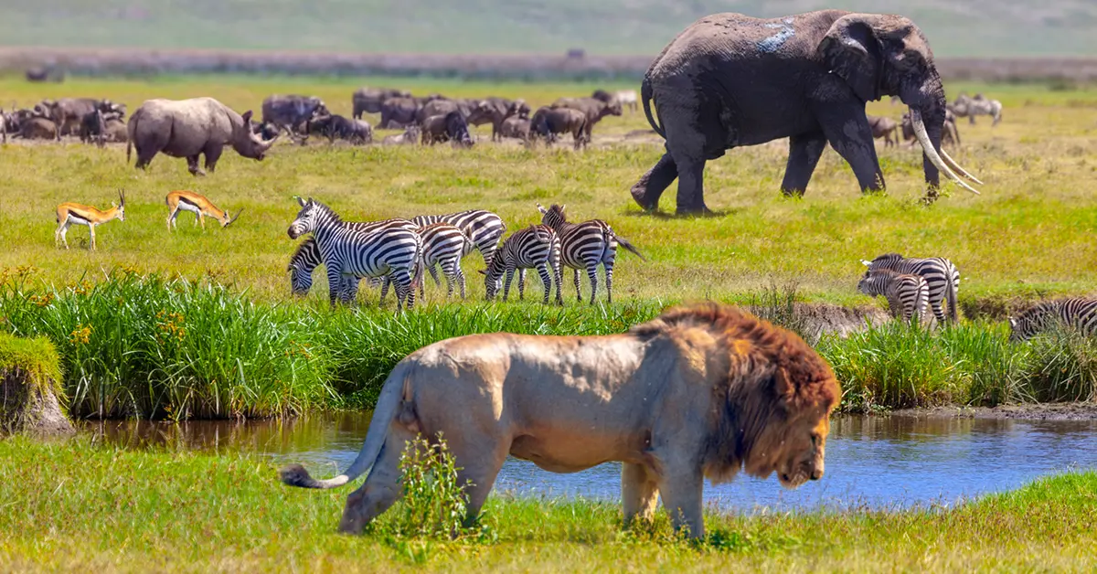
Loss of Biodiversity
Biodiversity - having many different types of plants, animals, and other living things in particular habitats on Earth. These living things are different in the types of species, genetic variations within the species, and ecosystems.
Biodiversity is important because different plants and animals depend on one another.
Because of climate change certain plants and animals are in danger of becoming extinct. As a results there are fewer types of plants and animals and a loss in biodiversity.

Slide 3
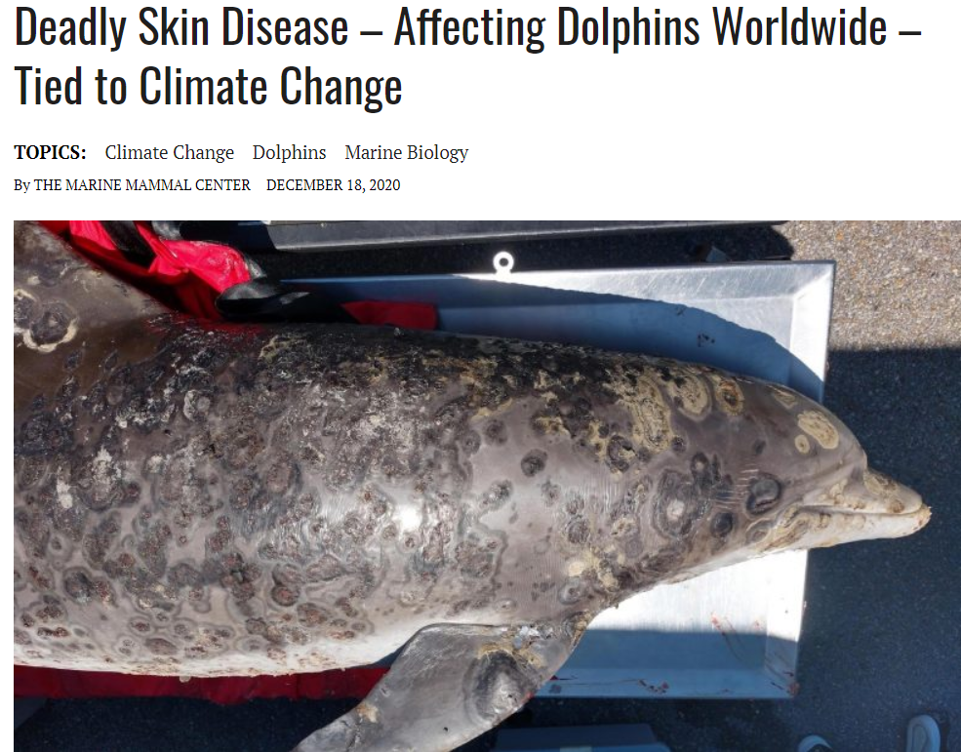
Some helpful Videos
What is Biodiversity: https://www.youtube.com/watch?v=b6Ua_zWDH6U
Biodiversity is collapsing worldwide. Here's why.: https://www.youtube.com/watch?v=1cvMX82iwRM
How does climate change affect plants and animals: https://www.youtube.com/watch?v=yD6khRIL0tc\
Ecological Impacts of Climate Change: https://www.youtube.com/watch?v=E2oxw7-_Ddc

Slide 4
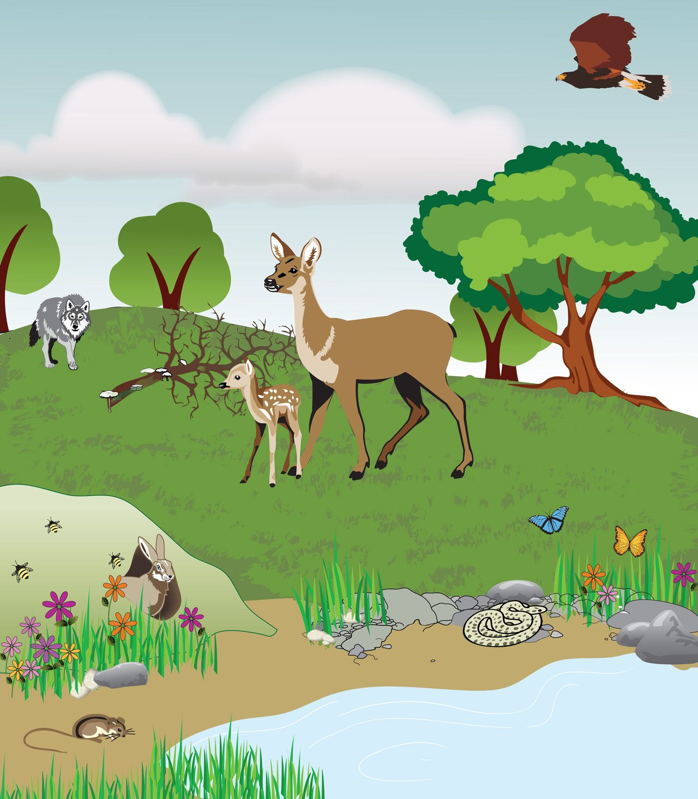
Altered Ecosystems (changes to populations, habitats, food chains, migrations, hibernation, nesting sites, etc)
Ecosystem “community of interacting organisms and their physical environment.”
For example the animals and plants in the picture to the right are all apart of this forest ecosystem.
Altered means something has changed
When an ecosystem is altered, there is a change in the ecosystem. Because the plants and animals in an ecosystem are connected, changing one part of the ecosystem, can have an impact on other parts of the ecosystem.

Slide 5
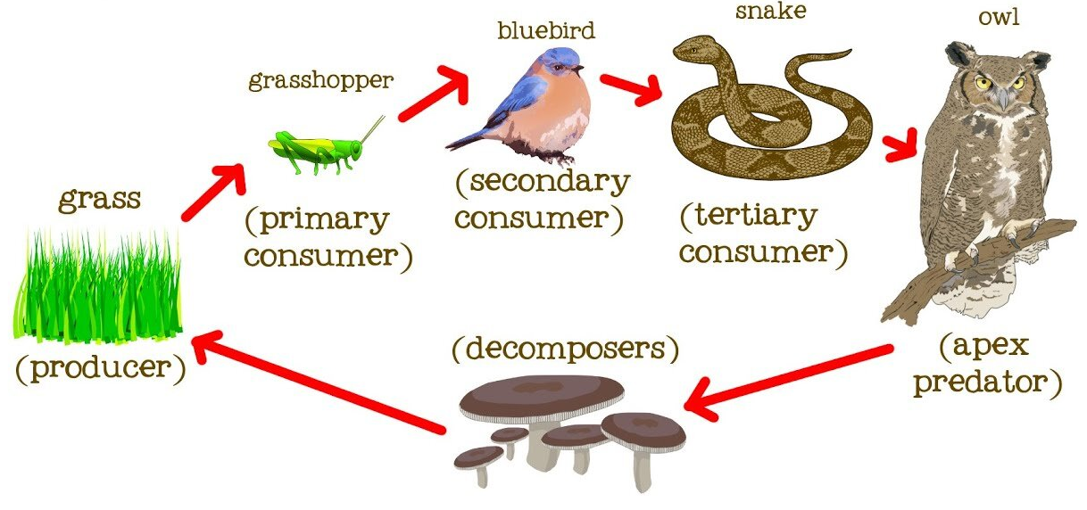
Examples of Altered Ecosystems -Foodweb
Food chains and food webs show the transfer of food energy in an ecosystem.
Food chains and food webs are useful, because you can predict and explain what will happen to other organism in the ecosystem if one organism’s population decreases.
For example if the the bluebird in this food web begins to die off, the snake will have little to eat and will either: die off, change their diet by eating more of another type of animal, or move out of the ecosystem into another. If the snake dies off or moves out of the ecosystem, this could mean the owl has less to eat.

Slide 6
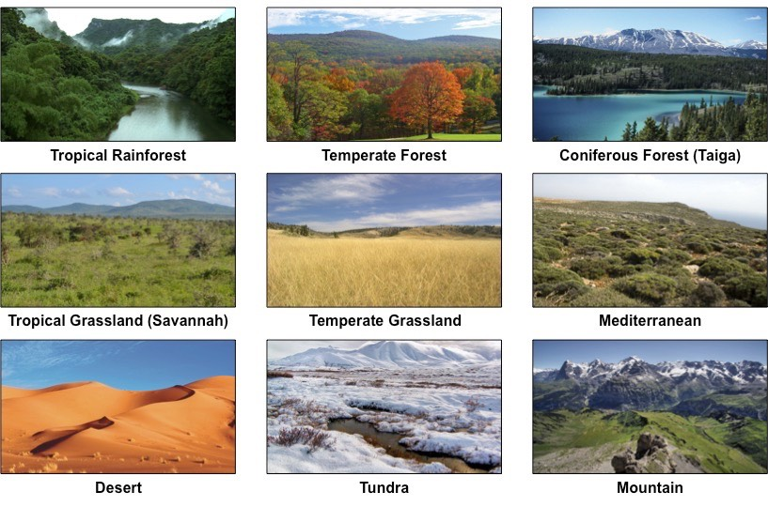
Types of Ecosystems
Ecosystems in different geological regions or in different places on Earth (called biomes), each with different types of plants and animals living there.
Some animals and plants are specialized to live in that biomes only. For example, a cactus plant would not survive in a rainforest because it has evolved to live in dry conditions.

Slide 7
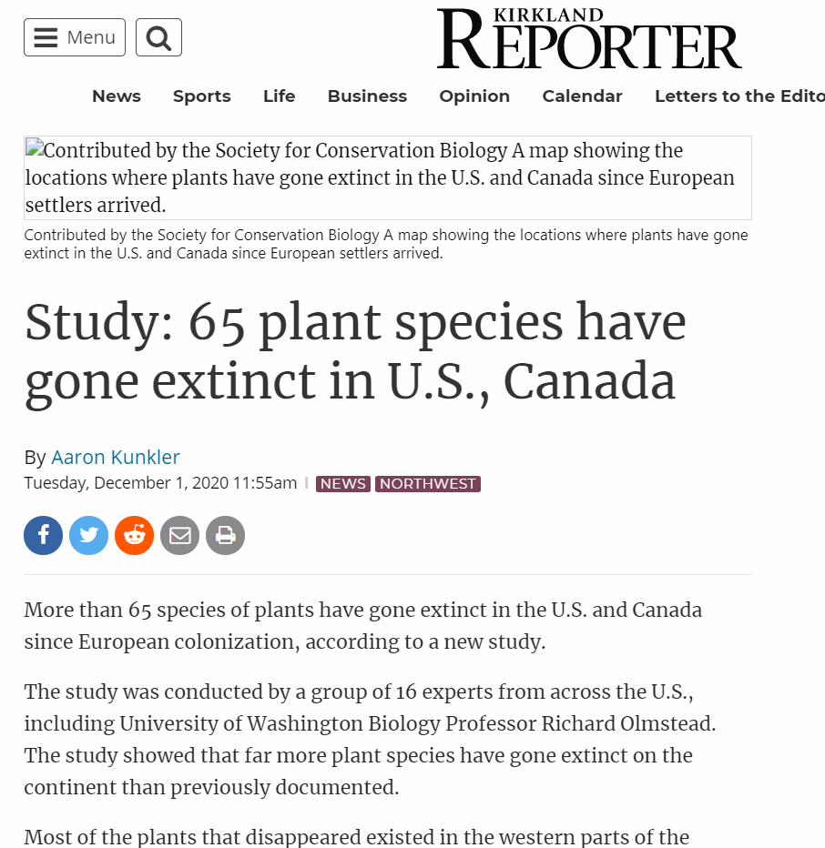
Helpful Videos
How Does Climate Change Impact Plants And Animals?: https://www.youtube.com/watch?v=yD6khRIL0tc
Ecological Impacts of Climate Change: https://www.youtube.com/watch?v=E2oxw7-_Ddc

Slide 8
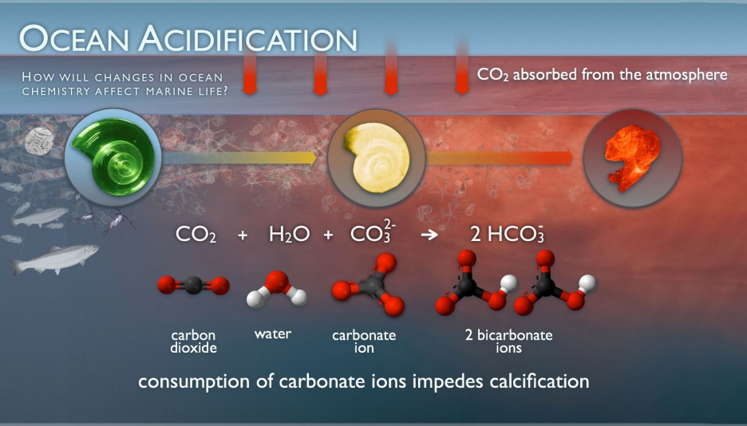
Ocean Acidification
Ocean acidification is the increase in the amount of acid in the ocean.
Ocean acidification is caused by increased amount of CO₂ dissolved in the oceans, which creates carbonic acid.
Acids are corrosive chemicals that can destroy shells of shellfish and coral reefs. Thus impacting marine ecosystems.
Dissolving Egg Shell With CO₂: https://www.youtube.com/watch?v=1Ta1FuesnK0
ACE Science Short: Ocean Acidification: https://www.youtube.com/watch?v=6SMWGV-DBnk

Slide 9
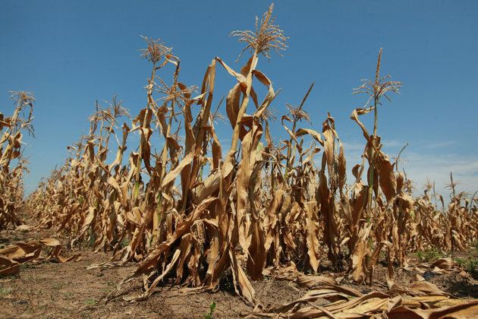
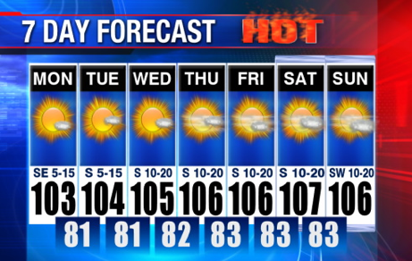
Droughts/ Heat waves
Drought is a long period of time with little precipitation (rain, snow) in a particular area.
Heatwave - A time when temperatures are higher than usual.
Both droughts and heatwaves can be dangerous and deadly to wildlife and humans.
Scientists believe that Climate change has been linked to longer, more frequent, and more intense droughts and heatwaves.

Slide 10
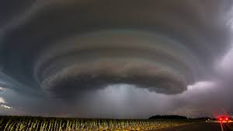
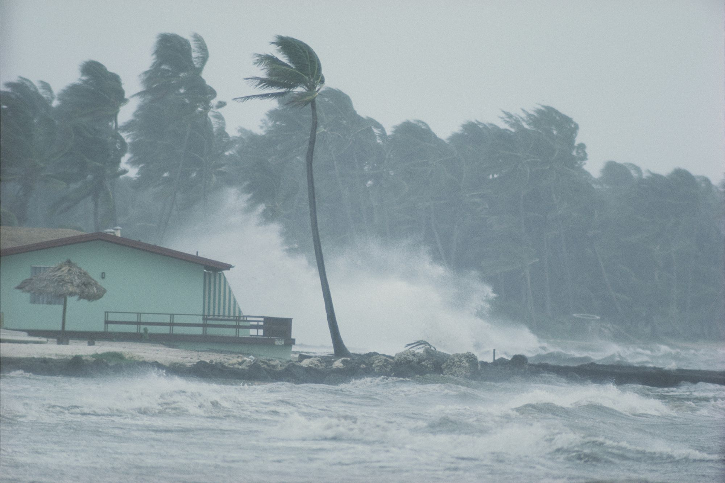
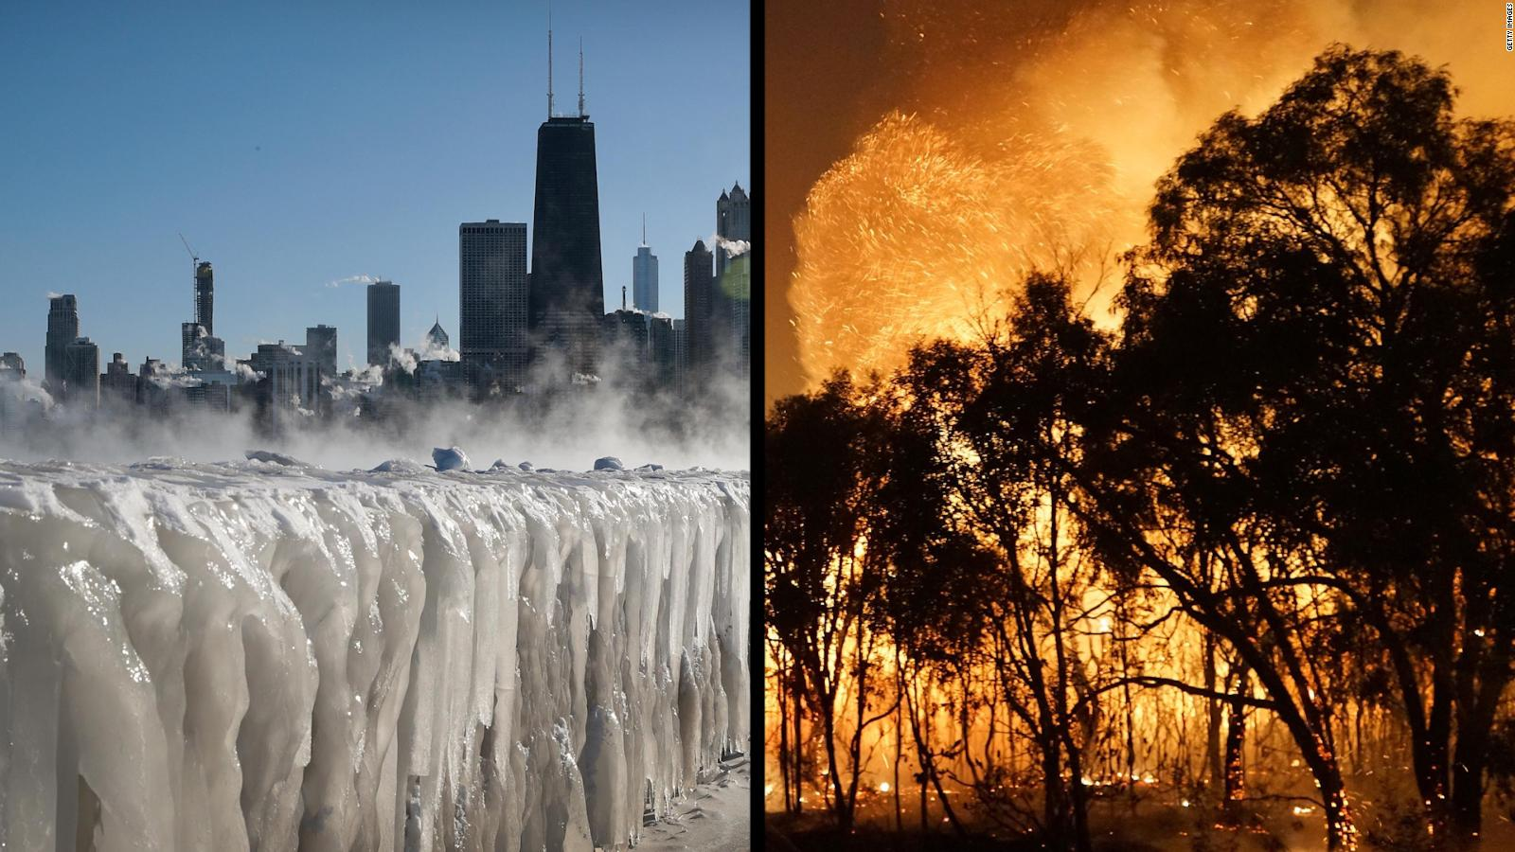
Storms/Natural Disasters/Changes to Weather Pattern
Weather patterns are becoming more extreme.
For example there are more severe…
Wildfires
Hurricanes
And storms
...than ever before.
Scientist believe this is due in part to climate change

Slide 11
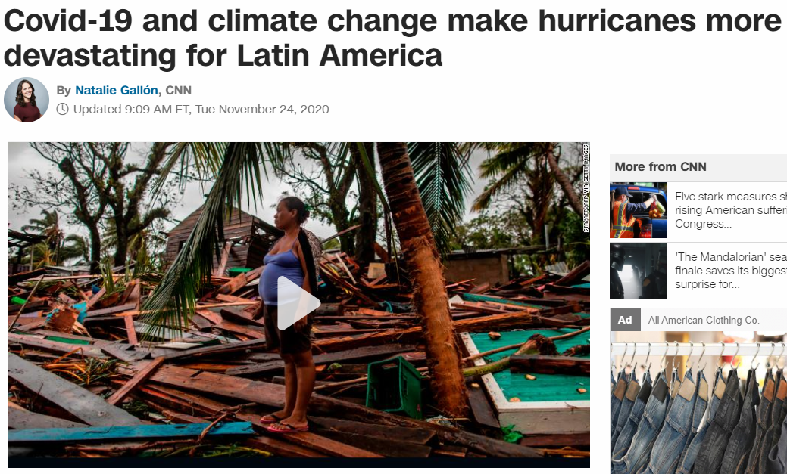
Videos for Droughts/ Heat waves & Storms/Natural Disasters/Changes to Weather Pattern
Does Climate Change Cause Extreme Weather?: https://www.youtube.com/watch?v=L4U4H5xLCoM
Why climate change makes extreme weather worse.: https://www.youtube.com/watch?v=1jzQF_IElGk

Slide 12
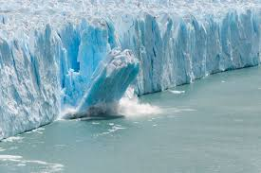
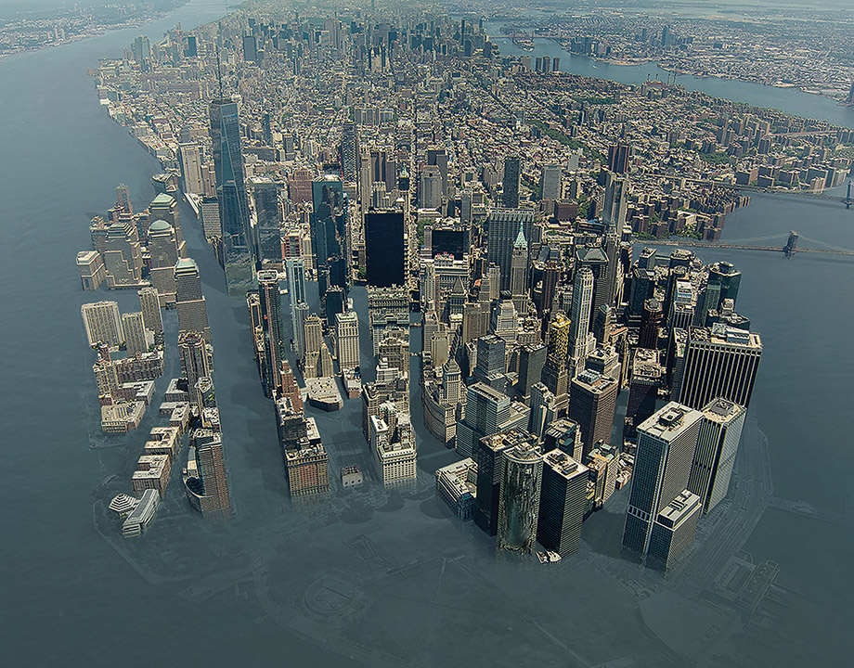
Flooding (sea level rise, storm surge flooding)
Rising global temperatures is melting the Earth’s ice.
As the ice melts into the sea it causes sea levels to rise.
Rising sea levels can lead to greater storm surges and flooding.
In addition, as sea levels rise some countries and cities that are below or near sea-level may be underwater.
The Hidden Impacts of Climate Change: https://www.youtube.com/watch?v=u6GRYrv2e3M

Slide 13
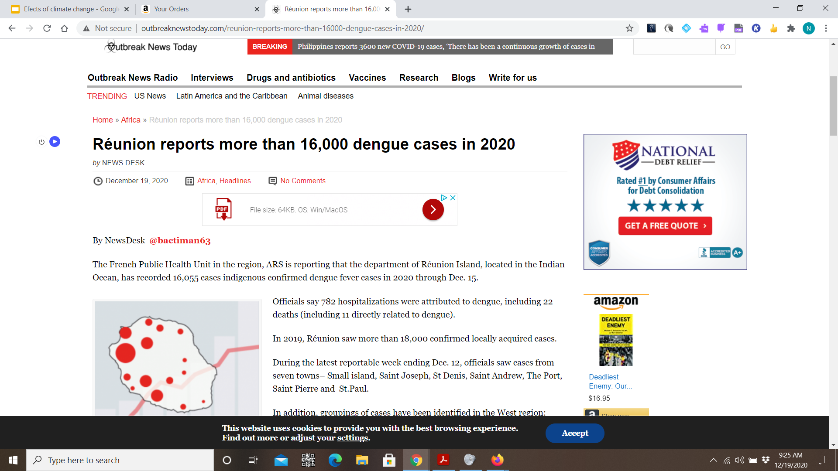
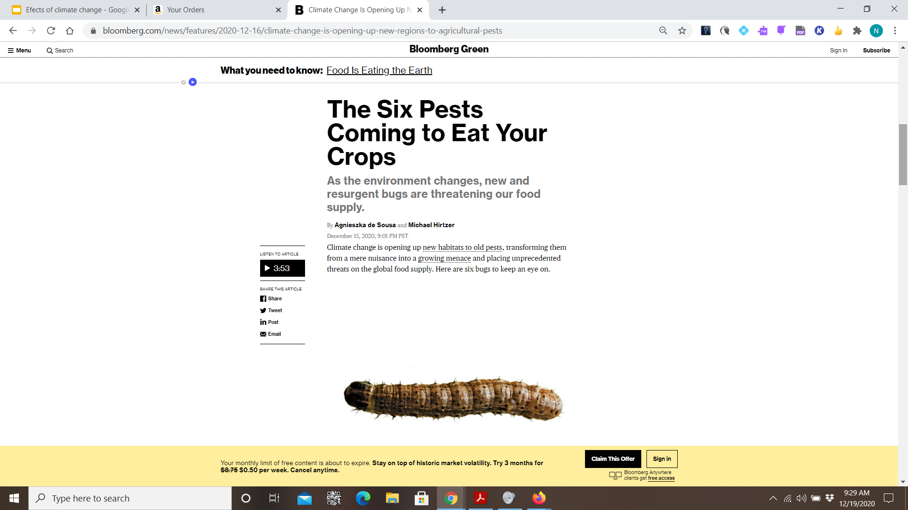
Diseases/Parasites or Infestations/Pests
Climate change has been linked to increases in the spread of diseases, and pests.
A common example includes Mosquito Borne illness like Dengue Fever which have spread to different parts of the world due to climate change.
How climate change can impact mosquito-borne diseases: https://www.youtube.com/w mnb atch?v=RA_3eWhVuD8
How climate affects community health: https://www.youtube.com/watch?v=JywsWktvODc

Slide 14
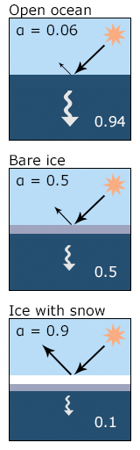
Melting Ice (Sea ice, glaciers & ice sheets, release methane, alter albedo, etc)
Albedo - is a term used to describe how reflective a surface is.
Ice and snow reflects light and have a high Albedo.
As the sea ice, glaciers, and ice sheets melt there is less ice on Earth to reflect solar radiation. As a result, more solar radiation is absorbed by the Earth, which in turn increases the temperature on Earth.
Thus melting ice is increasing the rate of Global warming and climate change.

Slide 15
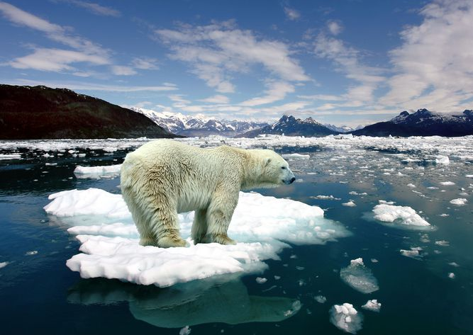
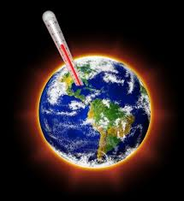
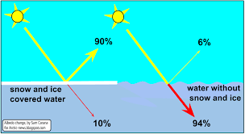
Positive Feedback Loop
Ice Melts
How Arctic warming changes ice-albedo, animation from NASA: https://www.youtube.com/watch?v=HT3IA8hN5JU
Arctic amplification: How the albedo effect speeds up global warming: https://www.youtube.com/watch?v=xZLX59FXr5w
More Radiation Absorbed
Increasing Temperature
Vestibulum congue tempus
Vestibulum congue tempus

Slide 16
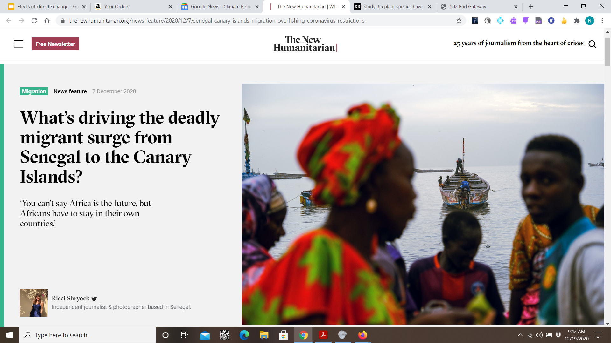
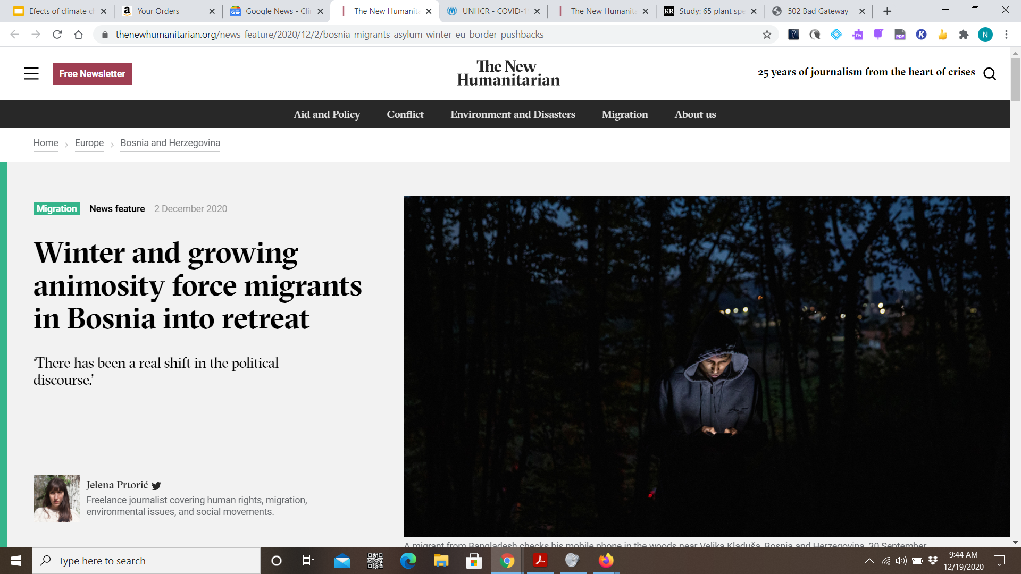
Human Health Effects (and access to food/water)
Climate change is impacting human access to food and freshwater
As a result many people may face starvation
Climate Health Connection Food and Water Insecurity: https://www.youtube.com/watch?v=zdUD6RBsDO4
Climate Change and Food Security Full Documentary: https://www.youtube.com/watch?v=QANPaNvjQ1o
Climate Change and Food Security: https://www.youtube.com/watch?v=jii7eesNecI
How climate crisis threatens world’s food supply and land: https://www.youtube.com/watch?v=pekk1vIMSkA
Fresh Water and Climate Change: https://www.youtube.com/watch?v=MjegikYedko
How climate affects community health: https://www.youtube.com/watch?v=JywsWktvODc

Slide 17
Access Videos from Google Slides

